Slide 1
Machine-Level Programming I: Basics Books: Programming from the ground up (Chapter 1-3) Computer Systems (Chapter 3)

Slide 2
Today: Machine Programming I: Basics
System organization basics
C, assembly, machine code
Assembly Basics: Registers, operands, move
Intro to x86-64

Slide 3
System Organization Basics
CPU
Memory
System Bus
I/O Devices

Slide 4
CPU
Control Unit
Execution Unit
Register
Flag
Control Unit: Retrieve / Decode instructions, Retrieve/ Store data in memory.
Execution Unit: Actual execution of instructions happen here.
Register: Temporary memory units; data can be accessed and stored faster.
Flag: Used to indicate various “event” when execution is in progress.

Slide 5
Registers
General Purpose Registers
EAX
EBX
ECX
EDX
ESI
EDI
ESP
EBP
Segment Registers
CS
DS
SS
ES
FS
GS
Instruction Pointer Registers
Control Registers
EIP
CR0
CR1
CR2
CR3
CR4

Slide 6
General Purpose Registers
EAX
Accumulator register, used for storing operands and result data
EBX
Base register, used for storing pointers to data
ECX
Counter register, used for loop operations
EDX
Data register, used for I/O pointer
ESI
EDI
Data pointer registers for memory operations
ESP
Stack pointer register
EBP
Stack base frame pointer

Slide 7
General Purpose Registers …
EAX
31
0
AX
31
16
15
0
AH
AL
15
8
7
0

Slide 8
Program Memory
High address
Stack
Used for storing function args and local vars
Unused Memory
Heap
Used for dynamic memory (e.g. malloc)
.bss
Uninitialized data
.data
Initialized data
Low address
.txt
Program code

Slide 9
Stack - Last In First Out (LIFO)
High Memory
ESP
Low Memory
ESP – Should point to the top of the stack
Push – inserts an element on the top (i.e. bottom of memory); ESP will move down
Pop – removes the top (i.e. ESP will move up) element from the stack
Note: Stack grows downward from the high memory to the low memory

Slide 10
Demo Time
Address space
Process map view
How to turn on/off randomization of the address space
Using GDB for
Examining the registers
Overview of stack layout

Slide 11
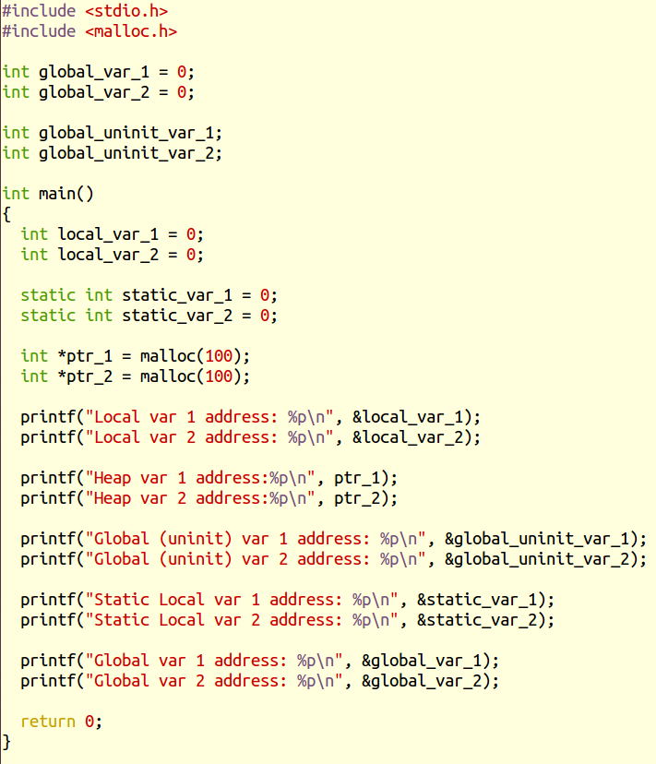
Sample program: address_layout.c
gcc -o address_layout address_layout.c -m32

Slide 12
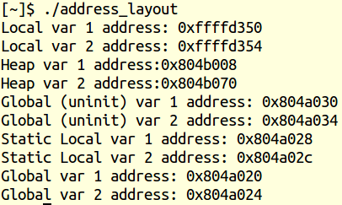
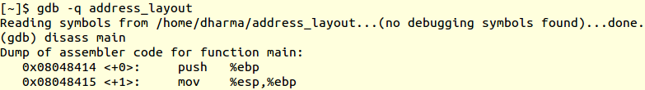
Address View
High address
Stack
Unused Memory
Heap
.bss
.data
Low address
.txt
Local variables are on the High Address region
Heap variables are below the local variables address
Uninitialized variables have higher addresses than initialized variables
Global variables are on the Low Address region
Static variables are “close” to initialized global variables
Code is in the Low address region

Slide 13
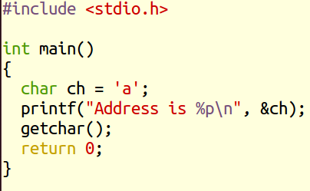
Sample Program: getch_stack_demo.c
gcc -o getch getch_stack_demo.c -m32

Slide 14
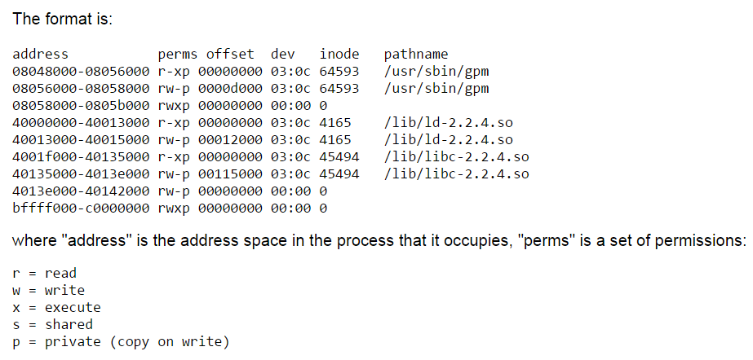
Process Map
/proc/[pid]/maps
A file containing the currently mapped memory regions and their access permissions

Slide 15
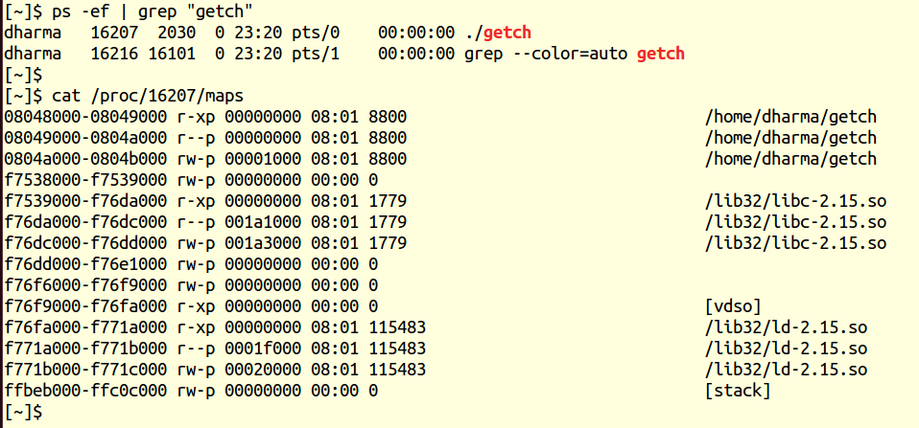
Process map of the sample program
Program code is in the lowest memory address
Stack is in the highest memory address

Slide 16
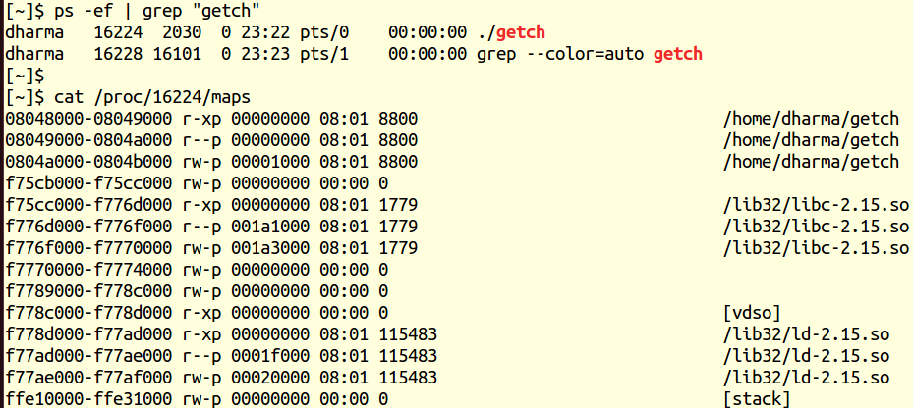
Rerun the same program again
Note: the stack address (the first column) has changed between runs

Slide 17
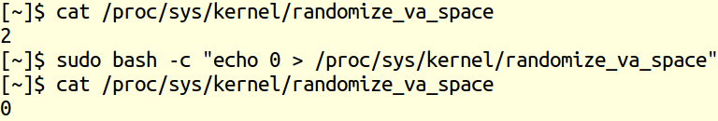
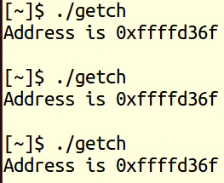
On/off randomized address space
To switch the address space randomization: run the following commands

Slide 18
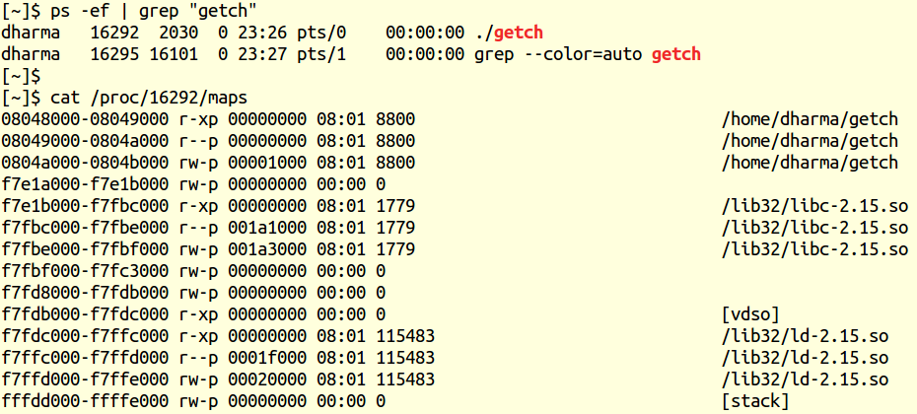
Run the program

Slide 19

Rerun the program
Note: Now the address space has not changed

Slide 20
Today: Machine Programming I: Basics
System organization basics
C, assembly, machine code
Assembly Basics: Registers, operands, move
Intro to x86-64

Slide 21
Assembly Programmer’s View
CPU
Memory
Registers
Addresses
PC
Object Code
Program Data
OS Data
Data
Condition
Codes
Instructions
Stack
Programmer-Visible State
PC: Program counter
Address of next instruction
Called “EIP” (IA32) or “RIP” (x86-64)
Register file
Heavily used program data
Condition codes
Store status information about most recent arithmetic operation
Used for conditional branching
Memory
Byte addressable array
Code, user data, (some) OS data
Includes stack used to support procedures

Slide 22
Turning C into Object Code
Code in files p1.c p2.c
Compile with command: gcc –O1 p1.c p2.c -o p
Use basic optimizations (-O1)
Put resulting binary in file p
text
C program (p1.c p2.c)
Compiler (gcc -S)
text
Asm program (p1.s p2.s)
Assembler (gcc or as)
binary
Object program (p1.o p2.o)
Static libraries (.a)
Linker (gcc or ld)
binary
Executable program (p)

Slide 23
Compiling Into Assembly
C Code
Generated IA32 Assembly
int sum(int x, int y)
{
int t = x+y;
return t;
}
sum:
pushl %ebp
movl %esp,%ebp
movl 12(%ebp),%eax
addl 8(%ebp),%eax
popl %ebp
ret
Some compilers use instruction “leave”
Obtain with command
/usr/local/bin/gcc –O1 -S code.c
Produces file code.s

Slide 24
Assembly Characteristics: Data Types
“Integer” data of 1, 2, or 4 bytes
Data values
Addresses (untyped pointers)
Floating point data of 4, 8, or 10 bytes
No aggregate types such as arrays or structures
Just contiguously allocated bytes in memory

Slide 25
Assembly Characteristics: Operations
Perform arithmetic function on register or memory data
Transfer data between memory and register
Load data from memory into register
Store register data into memory
Transfer control
Unconditional jumps to/from procedures
Conditional branches

Slide 26
Object Code
Code for sum
Assembler
Translates .s into .o
Binary encoding of each instruction
Nearly-complete image of executable code
Missing linkages between code in different files
Linker
Resolves references between files
Combines with static run-time libraries
E.g., code for malloc, printf
Some libraries are dynamically linked
Linking occurs when program begins execution
0x401040 <sum>:
0x55
0x89
0xe5
0x8b
0x45
0x0c
0x03
0x45
0x08
0x5d
0xc3
Total of 11 bytes
Each instruction 1, 2, or 3 bytes
Starts at address 0x401040

Slide 27
Machine Instruction Example
C Code
Add two signed integers
Assembly
Add 2 4-byte integers
“Long” words in GCC parlance
Same instruction whether signed or unsigned
Operands:
x: Register %eax
y: Memory M[%ebp+8]
t: Register %eax
Return function value in %eax
Object Code
3-byte instruction
Stored at address 0x80483ca
int t = x+y;
addl 8(%ebp),%eax
Similar to expression:
x += y
More precisely:
int eax;
int *ebp;
eax += ebp[2]
0x80483ca: 03 45 08

Slide 28
Disassembling Object Code
Disassembled
080483c4 <sum>:
80483c4: 55 push %ebp
80483c5: 89 e5 mov %esp,%ebp
80483c7: 8b 45 0c mov 0xc(%ebp),%eax
80483ca: 03 45 08 add 0x8(%ebp),%eax
80483cd: 5d pop %ebp
80483ce: c3 ret
Disassembler
objdump -d p
Useful tool for examining object code
Analyzes bit pattern of series of instructions
Produces approximate rendition of assembly code
Can be run on either a.out (complete executable) or .o file

Slide 29
Alternate Disassembly
Disassembled
Object
0x401040:
0x55
0x89
0xe5
0x8b
0x45
0x0c
0x03
0x45
0x08
0x5d
0xc3
Dump of assembler code for function sum:
0x080483c4 <sum+0>: push %ebp
0x080483c5 <sum+1>: mov %esp,%ebp
0x080483c7 <sum+3>: mov 0xc(%ebp),%eax
0x080483ca <sum+6>: add 0x8(%ebp),%eax
0x080483cd <sum+9>: pop %ebp
0x080483ce <sum+10>: ret
Within gdb Debugger
gdb p
disassemble sum
Disassemble procedure
x/11xb sum
Examine the 11 bytes starting at sum

Slide 30
What Can be Disassembled?
% objdump -d WINWORD.EXE
WINWORD.EXE: file format pei-i386
No symbols in "WINWORD.EXE".
Disassembly of section .text:
30001000 <.text>:
30001000: 55 push %ebp
30001001: 8b ec mov %esp,%ebp
30001003: 6a ff push $0xffffffff
30001005: 68 90 10 00 30 push $0x30001090
3000100a: 68 91 dc 4c 30 push $0x304cdc91
Anything that can be interpreted as executable code
Disassembler examines bytes and reconstructs assembly source

Slide 31
Integer Registers (IA32)
Origin
(mostly obsolete)
%eax
%ax
%ah
%al
accumulate
%ecx
%cx
%ch
%cl
counter
%edx
%dx
%dh
%dl
data
general purpose
%ebx
%bx
%bh
%bl
base
%esi
source
index
%si
%edi
destination
index
%di
%esp
stack
pointer
%sp
%ebp
base
pointer
%bp
16-bit virtual registers
(backwards compatibility)

Slide 32
Moving Data: IA32
%eax
%ecx
Moving Data
movl Source, Dest:
Operand Types
Immediate: Constant integer data
Example: $0x400, $-533
Like C constant, but prefixed with ‘$’
Encoded with 1, 2, or 4 bytes
Register: One of 8 integer registers
Example: %eax, %edx
But %esp and %ebp reserved for special use
Others have special uses for particular instructions
Memory: 4 consecutive bytes of memory at address given by register
Simplest example: (%eax)
Various other “address modes”
%edx
%ebx
%esi
%edi
%esp
%ebp

Slide 33
movl Operand Combinations
Source
Dest
Src,Dest
C Analog
Reg
movl $0x4,%eax
temp = 0x4;
Imm
Mem
movl $-147,(%eax)
*p = -147;
Reg
movl %eax,%edx
temp2 = temp1;
movl
Reg
Mem
movl %eax,(%edx)
*p = temp;
Mem
Reg
movl (%eax),%edx
temp = *p;
Cannot do memory-memory transfer with a single instruction

Slide 34
Simple Memory Addressing Modes
Normal (R) Mem[Reg[R]]
Register R specifies memory address movl (%ecx),%eax
Displacement D(R) Mem[Reg[R]+D]
Register R specifies start of memory region
Constant displacement D specifies offset movl 8(%ebp),%edx

Slide 35
Using Simple Addressing Modes
swap:
pushl %ebp
movl %esp,%ebp
pushl %ebx
movl 8(%ebp), %edx
movl 12(%ebp), %ecx
movl (%edx), %ebx
movl (%ecx), %eax
movl %eax, (%edx)
movl %ebx, (%ecx)
popl %ebx
popl %ebp
ret
void swap(int *xp, int *yp)
{
int t0 = *xp;
int t1 = *yp;
*xp = t1;
*yp = t0;
}
Set
Up
Body
Finish

Slide 36
Using Simple Addressing Modes
swap:
pushl %ebp
movl %esp,%ebp
pushl %ebx
movl 8(%ebp), %edx
movl 12(%ebp), %ecx
movl (%edx), %ebx
movl (%ecx), %eax
movl %eax, (%edx)
movl %ebx, (%ecx)
popl %ebx
popl %ebp
ret
void swap(int *xp, int *yp)
{
int t0 = *xp;
int t1 = *yp;
*xp = t1;
*yp = t0;
}
Set
Up
Body
Finish

Slide 37
Understanding Swap
•
•
•
void swap(int *xp, int *yp)
{
int t0 = *xp;
int t1 = *yp;
*xp = t1;
*yp = t0;
}
Stack
(in memory)
Offset
12
yp
8
xp
4
Rtn adr
0
Old %ebp
%ebp
-4
Old %ebx
%esp
Register Value
%edx xp
%ecx yp
%ebx t0
%eax t1
movl 8(%ebp), %edx # edx = xp
movl 12(%ebp), %ecx # ecx = yp
movl (%edx), %ebx # ebx = *xp (t0)
movl (%ecx), %eax # eax = *yp (t1)
movl %eax, (%edx) # *xp = t1
movl %ebx, (%ecx) # *yp = t0

Slide 38
Understanding Swap
Address
123
0x124
456
0x120
0x11c
%eax
0x118
%edx
Offset
0x114
%ecx
yp
12
0x120
0x110
xp
8
0x124
0x10c
%ebx
4
Rtn adr
0x108
%esi
%ebp
0
0x104
%edi
-4
0x100
%esp
movl 8(%ebp), %edx # edx = xp
movl 12(%ebp), %ecx # ecx = yp
movl (%edx), %ebx # ebx = *xp (t0)
movl (%ecx), %eax # eax = *yp (t1)
movl %eax, (%edx) # *xp = t1
movl %ebx, (%ecx) # *yp = t0
%ebp
0x104

Slide 39
Understanding Swap
Address
123
0x124
456
0x120
0x11c
%eax
0x118
%edx
0x124
Offset
0x114
yp
12
0x120
%ecx
0x120
0x110
xp
8
0x124
0x10c
%ebx
4
Rtn adr
0x108
%esi
%ebp
0
0x104
%edi
-4
0x100
%esp
movl 8(%ebp), %edx # edx = xp
movl 12(%ebp), %ecx # ecx = yp
movl (%edx), %ebx # ebx = *xp (t0)
movl (%ecx), %eax # eax = *yp (t1)
movl %eax, (%edx) # *xp = t1
movl %ebx, (%ecx) # *yp = t0
%ebp
0x104

Slide 40
Understanding Swap
Address
123
0x124
456
0x120
0x11c
%eax
0x118
%edx
0x124
Offset
0x114
%ecx
0x120
yp
12
0x120
0x110
xp
8
0x124
0x124
0x10c
%ebx
4
Rtn adr
0x108
%esi
%ebp
0
0x104
%edi
-4
0x100
%esp
movl 8(%ebp), %edx # edx = xp
movl 12(%ebp), %ecx # ecx = yp
movl (%edx), %ebx # ebx = *xp (t0)
movl (%ecx), %eax # eax = *yp (t1)
movl %eax, (%edx) # *xp = t1
movl %ebx, (%ecx) # *yp = t0
%ebp
0x104

Slide 41
Understanding Swap
Address
123
0x124
456
456
0x120
0x11c
%eax
0x118
%edx
0x124
Offset
0x114
%ecx
0x120
yp
12
0x120
0x110
xp
8
0x124
0x10c
%ebx
123
4
Rtn adr
0x108
%esi
%ebp
0
0x104
%edi
-4
0x100
%esp
movl 8(%ebp), %edx # edx = xp
movl 12(%ebp), %ecx # ecx = yp
movl (%edx), %ebx # ebx = *xp (t0)
movl (%ecx), %eax # eax = *yp (t1)
movl %eax, (%edx) # *xp = t1
movl %ebx, (%ecx) # *yp = t0
%ebp
0x104

Slide 42
Understanding Swap
Address
123
123
0x124
456
0x120
0x11c
%eax
456
0x118
%edx
0x124
Offset
0x114
%ecx
0x120
yp
12
0x120
0x110
xp
8
0x124
0x10c
%ebx
123
4
Rtn adr
0x108
%esi
%ebp
0
0x104
%edi
-4
0x100
%esp
movl 8(%ebp), %edx # edx = xp
movl 12(%ebp), %ecx # ecx = yp
movl (%edx), %ebx # ebx = *xp (t0)
movl (%ecx), %eax # eax = *yp (t1)
movl %eax, (%edx) # *xp = t1
movl %ebx, (%ecx) # *yp = t0
%ebp
0x104

Slide 43
Understanding Swap
Address
456
0x124
456
0x120
0x11c
%eax
456
456
0x118
%edx
0x124
Offset
0x114
%ecx
0x120
yp
12
0x120
0x110
xp
8
0x124
0x10c
%ebx
123
123
4
Rtn adr
0x108
%esi
%ebp
0
0x104
%edi
-4
0x100
%esp
movl 8(%ebp), %edx # edx = xp
movl 12(%ebp), %ecx # ecx = yp
movl (%edx), %ebx # ebx = *xp (t0)
movl (%ecx), %eax # eax = *yp (t1)
movl %eax, (%edx) # *xp = t1
movl %ebx, (%ecx) # *yp = t0
%ebp
0x104

Slide 44
Understanding Swap
Address
456
0x124
123
0x120
0x11c
%eax
456
0x118
%edx
0x124
Offset
0x114
%ecx
0x120
yp
12
0x120
0x110
xp
8
0x124
0x10c
%ebx
123
123
4
Rtn adr
0x108
%esi
%ebp
0
0x104
%edi
-4
0x100
%esp
movl 8(%ebp), %edx # edx = xp
movl 12(%ebp), %ecx # ecx = yp
movl (%edx), %ebx # ebx = *xp (t0)
movl (%ecx), %eax # eax = *yp (t1)
movl %eax, (%edx) # *xp = t1
movl %ebx, (%ecx) # *yp = t0
%ebp
0x104

Slide 45
Complete Memory Addressing Modes
Most General Form
D(Rb,Ri,S) Mem[Reg[Rb]+S*Reg[Ri]+ D]
D: Constant “displacement” 1, 2, or 4 bytes
Rb: Base register: Any of 8 integer registers
Ri: Index register: Any, except for %esp
Unlikely you’d use %ebp, either
S: Scale: 1, 2, 4, or 8
Special Cases
(Rb,Ri) Mem[Reg[Rb]+Reg[Ri]]
D(Rb,Ri) Mem[Reg[Rb]+Reg[Ri]+D]
(Rb,Ri,S) Mem[Reg[Rb]+S*Reg[Ri]]

Slide 46
Today: Machine Programming I: Basics
System organization basics
C, assembly, machine code
Assembly Basics: Registers, operands, move
Intro to x86-64

Slide 47
Data Representations: IA32 + x86-64
Sizes of C Objects (in Bytes)
C Data Type Generic 32-bit Intel IA32 x86-64
unsigned 4 4 4
int 4 4 4
long int 4 4 8
char 1 1 1
short 2 2 2
float 4 4 4
double 8 8 8
long double 8 10/12 16
char * 4 4 8
Or any other pointer

Slide 48
x86-64 Integer Registers
%rax
%r8
%eax
%r8d
%rbx
%r9
%ebx
%r9d
%rcx
%r10
%ecx
%r10d
%rdx
%r11
%edx
%r11d
%rsi
%r12
%esi
%r12d
%rdi
%r13
%edi
%r13d
%rsp
%r14
%esp
%r14d
%rbp
%r15
%ebp
%r15d
Extend existing registers. Add 8 new ones.
Make %ebp/%rbp general purpose

Slide 49
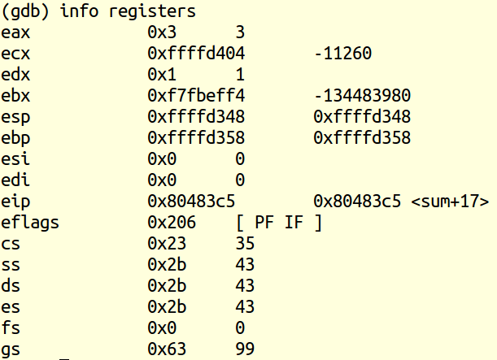
Registers of x32

Slide 50
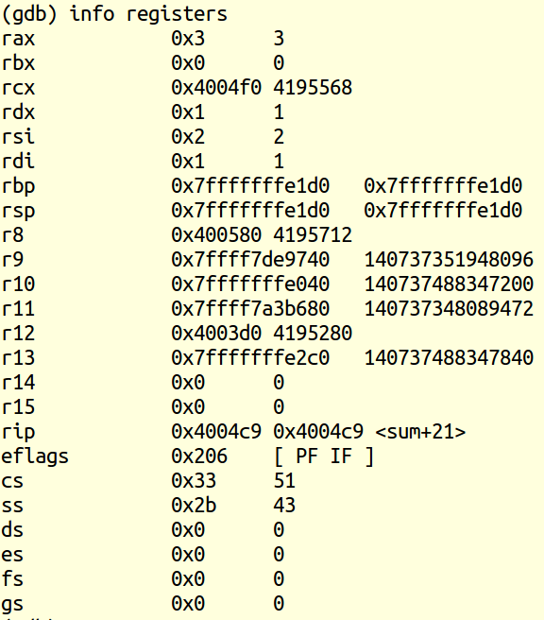
Registers of x64
8 additional registers

Slide 51
Instructions
Long word l (4 Bytes) ↔ Quad word q (8 Bytes)
New instructions:
movl ➙ movq
addl ➙ addq
sall ➙ salq
etc.
32-bit instructions that generate 32-bit results
Set higher order bits of destination register to 0
Example: addl

Slide 52
32-bit code for swap
swap:
pushl %ebp
movl %esp,%ebp
pushl %ebx
movl 8(%ebp), %edx
movl 12(%ebp), %ecx
movl (%edx), %ebx
movl (%ecx), %eax
movl %eax, (%edx)
movl %ebx, (%ecx)
popl %ebx
popl %ebp
ret
void swap(int *xp, int *yp)
{
int t0 = *xp;
int t1 = *yp;
*xp = t1;
*yp = t0;
}
Set
Up
Body
Finish

Slide 53
64-bit code for swap
swap:
movl (%rdi), %edx
movl (%rsi), %eax
movl %eax, (%rdi)
movl %edx, (%rsi)
ret
Set
Up
void swap(int *xp, int *yp)
{
int t0 = *xp;
int t1 = *yp;
*xp = t1;
*yp = t0;
}
Body
Finish
Operands passed in registers (why useful?)
First (xp) in %rdi, second (yp) in %rsi
64-bit pointers
No stack operations required
32-bit data
Data held in registers %eax and %edx
movl operation

Slide 54
64-bit code for long int swap
swap_l:
movq (%rdi), %rdx
movq (%rsi), %rax
movq %rax, (%rdi)
movq %rdx, (%rsi)
ret
Set
Up
void swap(long *xp, long *yp)
{
long t0 = *xp;
long t1 = *yp;
*xp = t1;
*yp = t0;
}
Body
Finish
64-bit data
Data held in registers %rax and %rdx
movq operation
“q” stands for quad-word

Slide 55
Generate 32-bit code on 64-bit pc?
gcc –m32 program.c
Note: data types can have different sizes on 32 bit vs 64 bit
Programs that work well on a 32 bit machine may not work on a 64 bit

Slide 56
Machine Programming I: Summary
C, assembly, machine code
Compiler must transform statements, expressions, procedures into low-level instruction sequences
Assembly Basics: Registers, operands, move
The x86 move instructions cover wide range of data movement forms
Intro to x86-64
A major departure from the style of code seen in IA32

